Slide 1
Optical Properties of Amorphous Nanolayers
Nicholas A. Kuhta
Oregon State University – Physics
kuhtan@onid.orst.edu
Collaborators:
Bill Cowell (OSU Electrical Engineering)
Chris Knutson (OSU Chemistry)
Oregon State University SSO Seminar 04/06/2010

Slide 2
Outline:
Introduce Metamaterials/Plasmonics and discuss modern applications.
Overview fabrication and characterization of our bulk and
layered amorphous metal-dielectric metamaterials.
Show the optical properties of our structures – interesting conductivity
response, anisotropic, effective medium, hyperbolic dispersion.

Slide 3
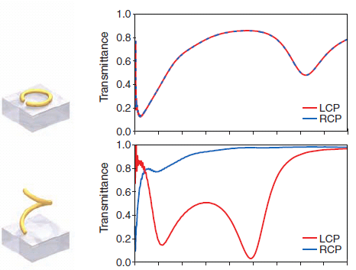
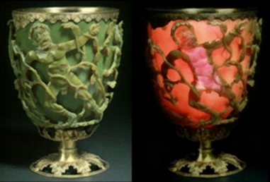
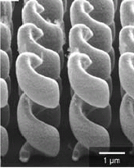
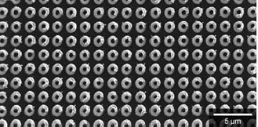
Controlling Light at the Nanoscale
DNA sensing -Gold nanoparticle
cluster size/dimension changes color.
Lee et. al Nano Lett. 9, 4564 (2009)
Roman Goblet from 4th century A.D.
Gansel et. Al Science 325, 1513 (2009)

Slide 4
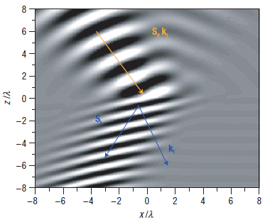
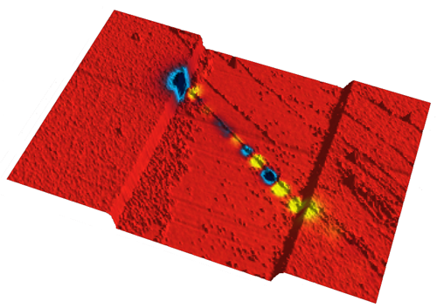
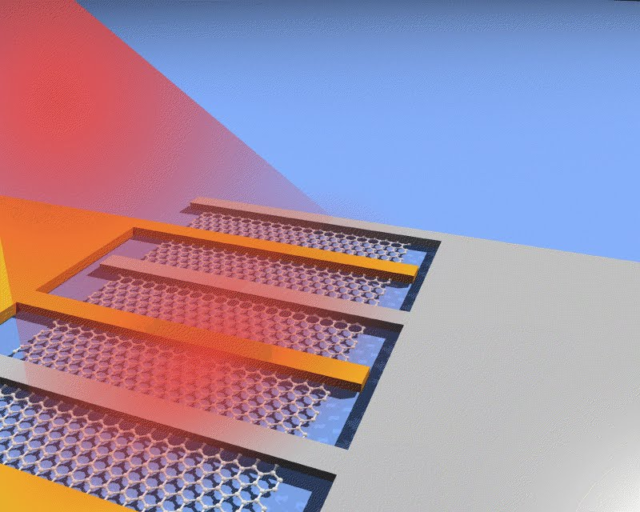
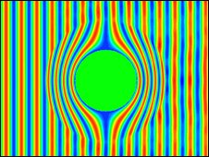
More Nano-Optics
CNT photocurrent – Minot Group OSU
Hoffman et. al Nature Materials (2007)
Pendry et. al Science 312 (2006)
IBM – FET with graphene channel (10GB/s)

Slide 5
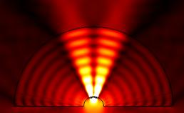
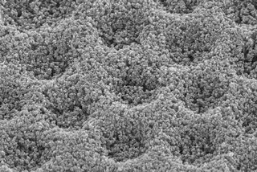
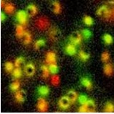
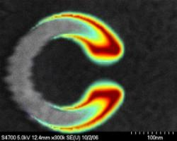
Metamaterial Application Goals:
Subwavelength imaging – beating the diffraction limit
Superfocusing – sub-diffraction
Cloaking – Super-absorbers (optical black hole)
Improved data storage via enhanced nanocontrol
High speed optoelectronic/photonic devices (Optical Computing)
New Sensor technology for Biological species
Dispersion Engineering (this work)
New Physics!!!
J. Lee - Acoustic Microscope
McGehee –
plasmonic
solar cells
Hulst –
Single molecule
nanoscale probe
Clark – split ring resonator

Slide 6
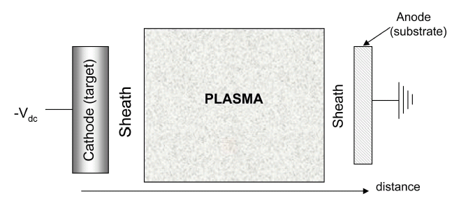
Amorphous Metal Nanofabrication – DC Magnetron Sputtering
Targets:
ZrCuAlNi
TiAl₃
Experimental Technique:
Positively Charged Argon Plasma (color) – ejects atomic species from metal target.
Neutral ejected particles travel and are deposited on substrate in thin film form.
Pressure controls deposition rate (scattering)
Pros:
Uniform high deposition rate
Targets provide easy control of stoichiometry
Cons:
Requires vacuum apparatus
Cowell, Masters Thesis OSU (2010)

Slide 7
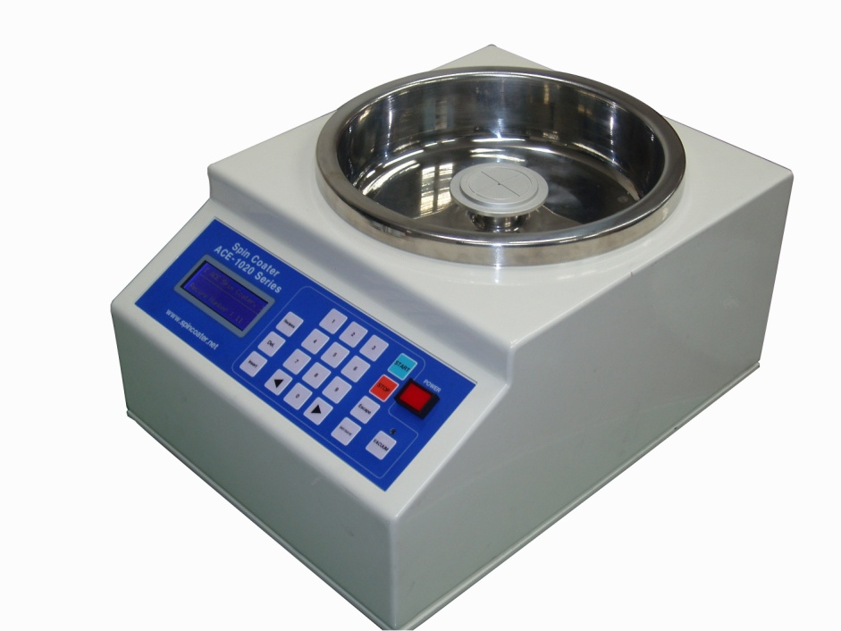
Dielectric Thin Film Deposition – Solution Spin Coating
Experimental Technique:
Inorganic aqueous-solution-processed oxide sample (ALPO)
Utilize surface tension to produce atomically smooth layers using spin-coating.
After the timed spin put on hot plate to remove water. (MOM bonds)
Pros:
Very inexpensive
Highly accurate – reproducible
Scalable
Cons:
Limited Material Set
Getting materials in solution
Knutson et. al (in preparation)

Slide 8
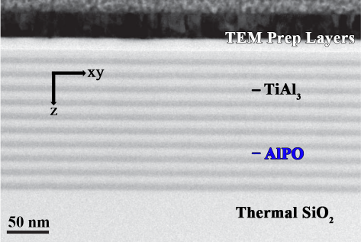
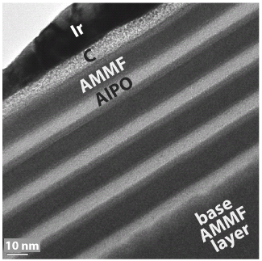
TEM micrographs – Planar Metal-Dielectric Nanostructures
TiAl₃ – ALPO stack system
ZrCuAlNi – ALPO stack system
Cowell et. al Applied Materials
& Interfaces (2011)

Slide 9
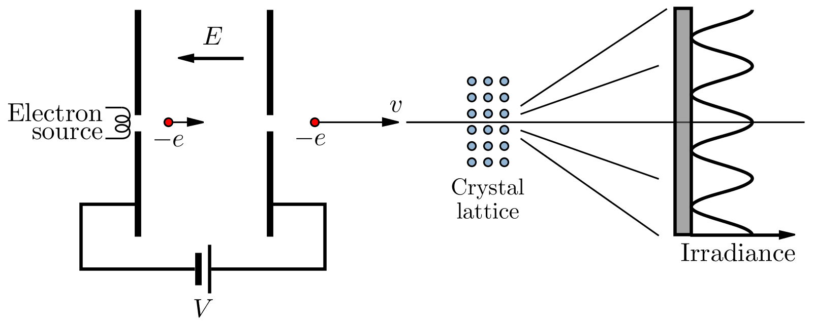
Electron Diffraction Schematic
Speckled pattern = Crystalline Structure (long range spatially repeating order)
Diffuse pattern = Amorphous Structure (no structure - disordered)

Slide 10
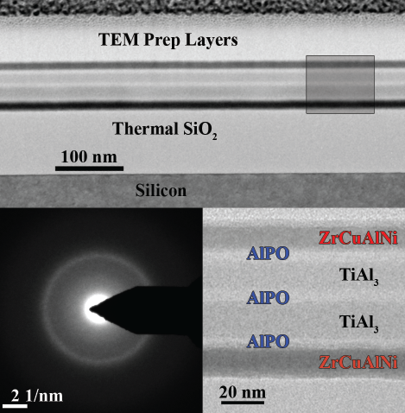
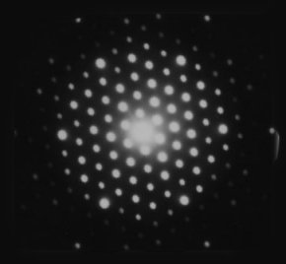
Amorphous Morphology – Electron Diffraction
single
crystalline
Amorphous (no long range order)

Slide 11
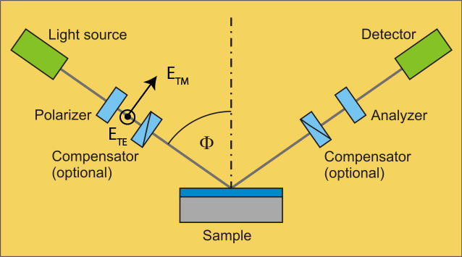
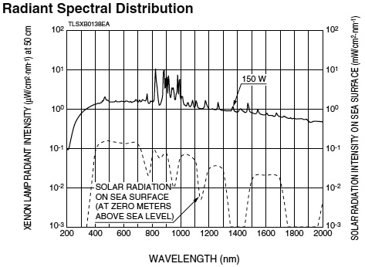
Light-source:
Xe Lamp
(190nm-2400nm)
Spectroscopic Ellipsometry - Reflectance
Xe Lamp Spectrum
Measurement parameters:
Measure reflectance for angles between 20 and 80 degrees
Reflectance measurements range from 300nm to 1500nm
Both TE and TM polarization reflectance is measured
Negligible coupling between output TE and TM polarization states

Slide 12
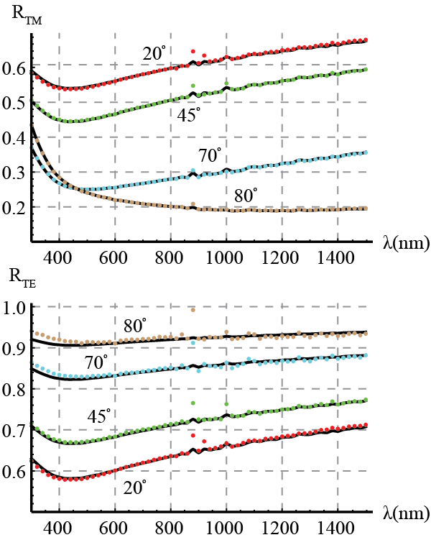
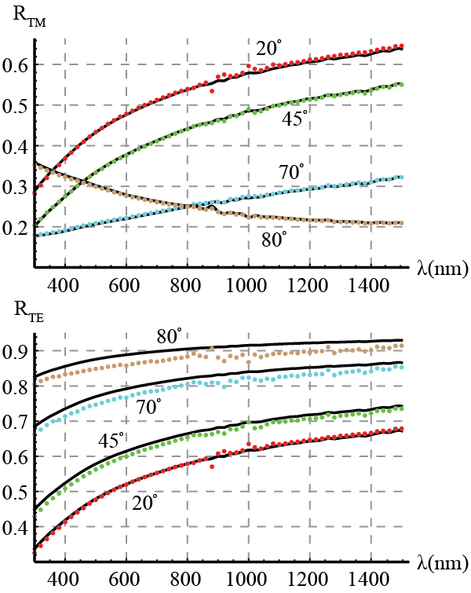
Single Layer (Thick Film) Reflectance - Ellipsometry
200nm - TiAl₃
284nm - ZrCuAlNi

Slide 13
Extracting Dielectric Response
In optically thick metals reflection only comes from the top interface
Note we’re using non-magnetic materials

Slide 14
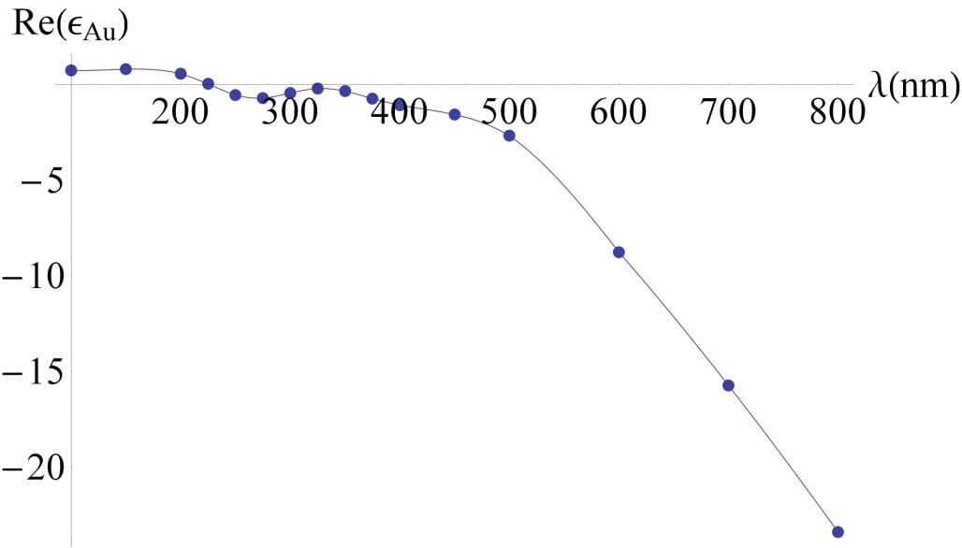
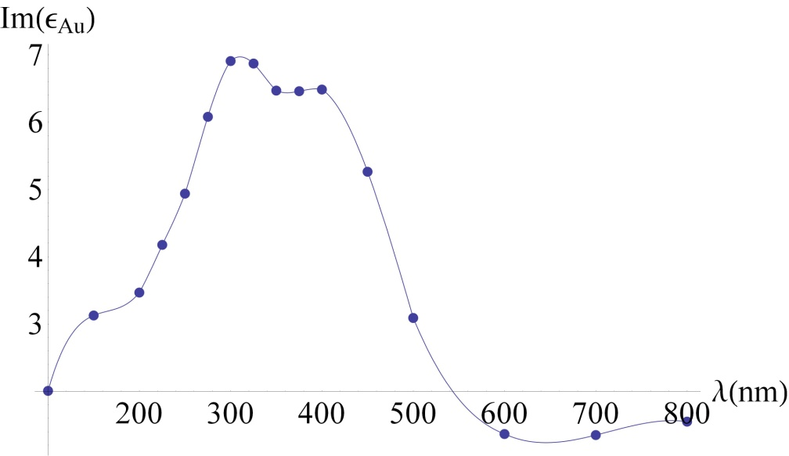
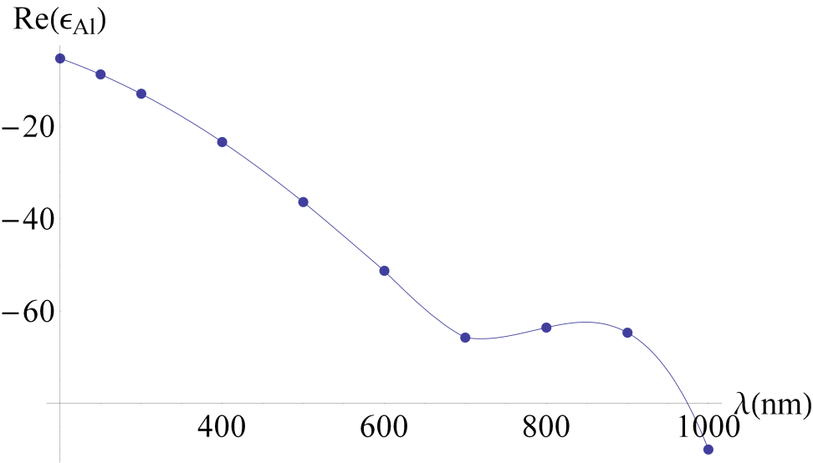
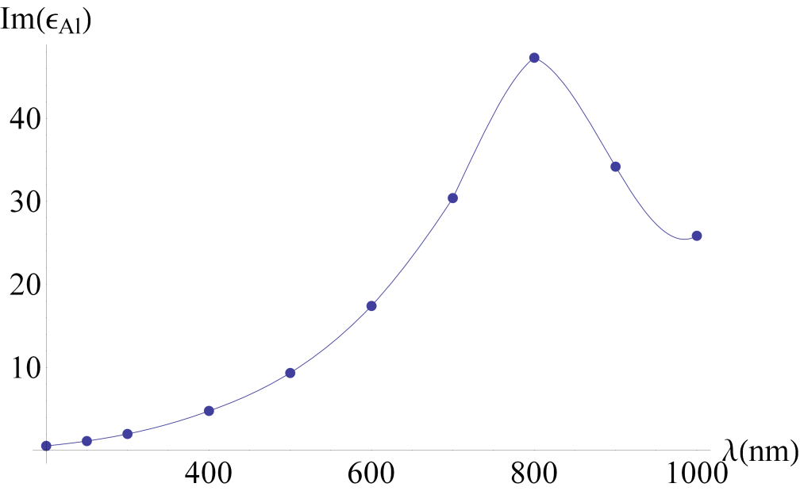
Gold – Dielectric Response
Aluminum – Dielectric Response
Palik,"Handbook of Optical Constants of Solids," Academic Press (luxpop.com)

Slide 15
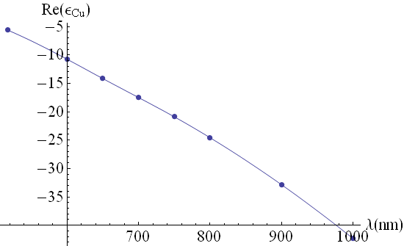
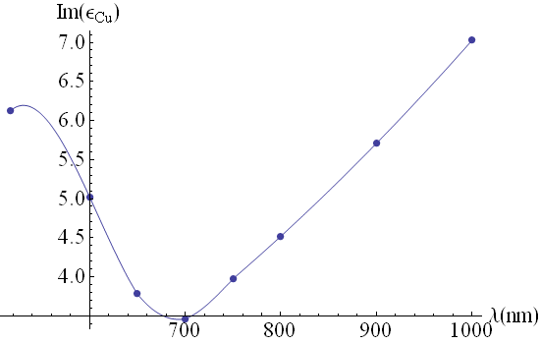
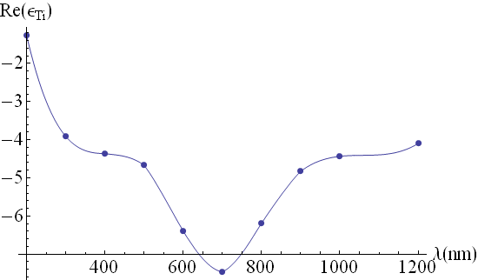
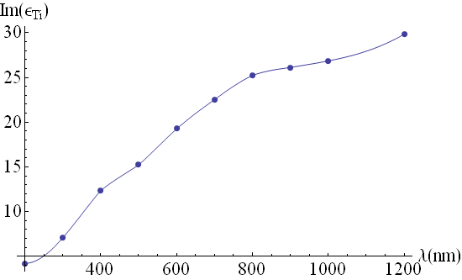
Copper – Dielectric Response
Titanium – Dielectric Response
Palik,"Handbook of Optical Constants of Solids," Academic Press.

Slide 16
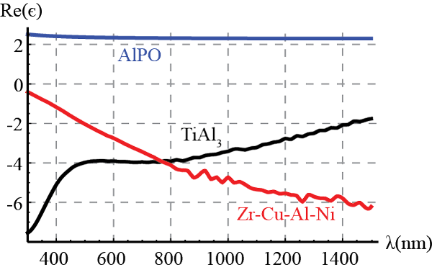
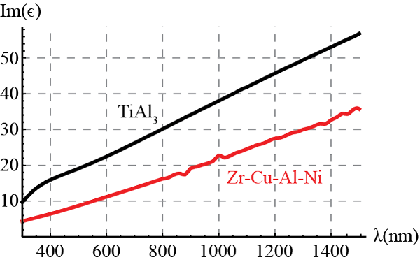
Bulk Dielectric Constants
Note the different response
for each metal!
As with all plasmonic
systems loss plays a
major role.

Slide 17
Quasistatic Effective Medium Theory (Planar)
Due to the small thickness of
each material layer with respect to the laser wavelength (quasistatic) the material responds as an average anisotropic effective medium.

Slide 18
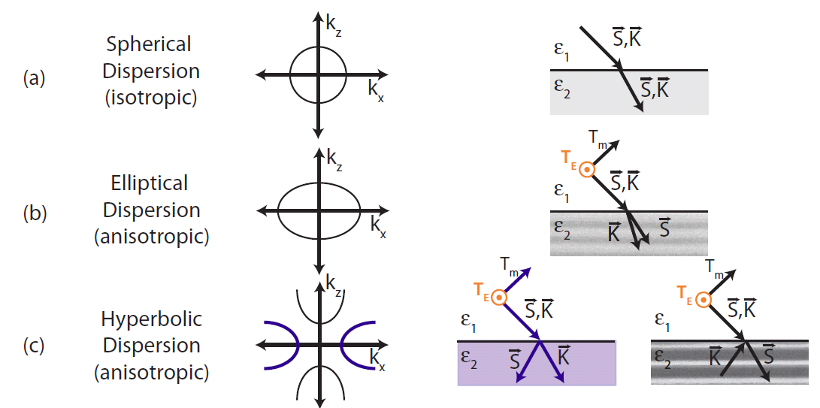
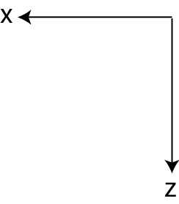
Anisotropic Dispersion Equation and Poynting Vector
isotropic
anisotropic

Slide 19
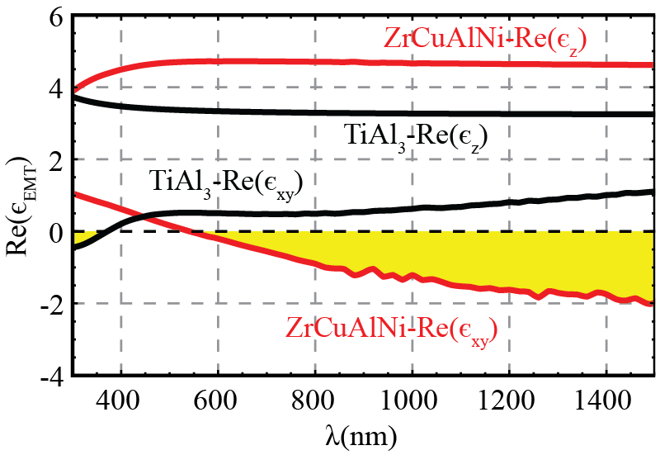
Anisotropic Dielectric Response – Effective Medium

Slide 20
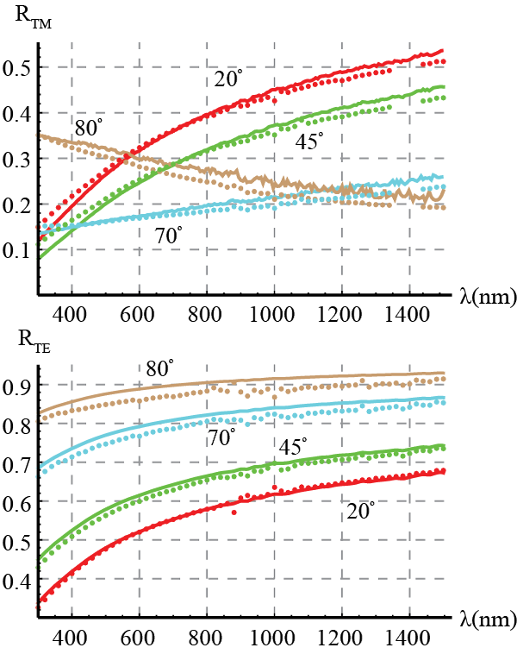
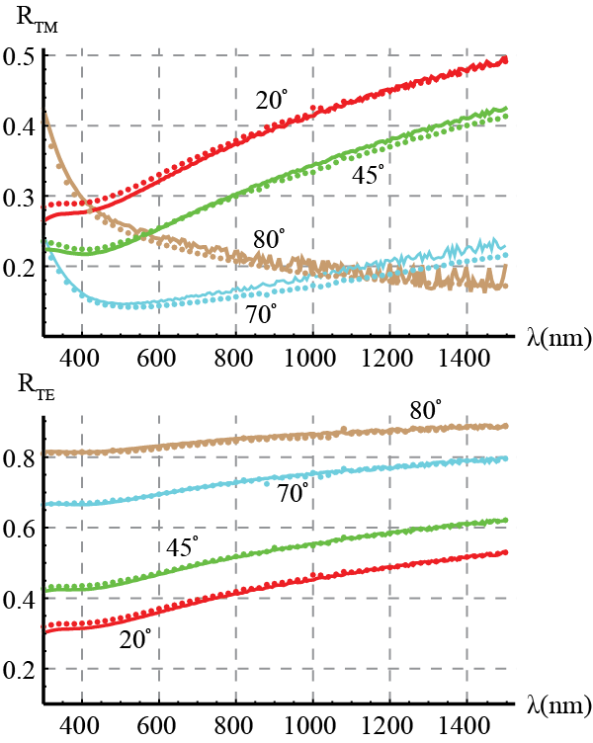
Multi-Layer Optical Reflectance – EMT Model
10 bilayers – 8nm (ZrCuAlNi), 8nm AlPO
10 bilayers – 4.7nm TiAl₃, 11.3nm AlPO

Slide 21
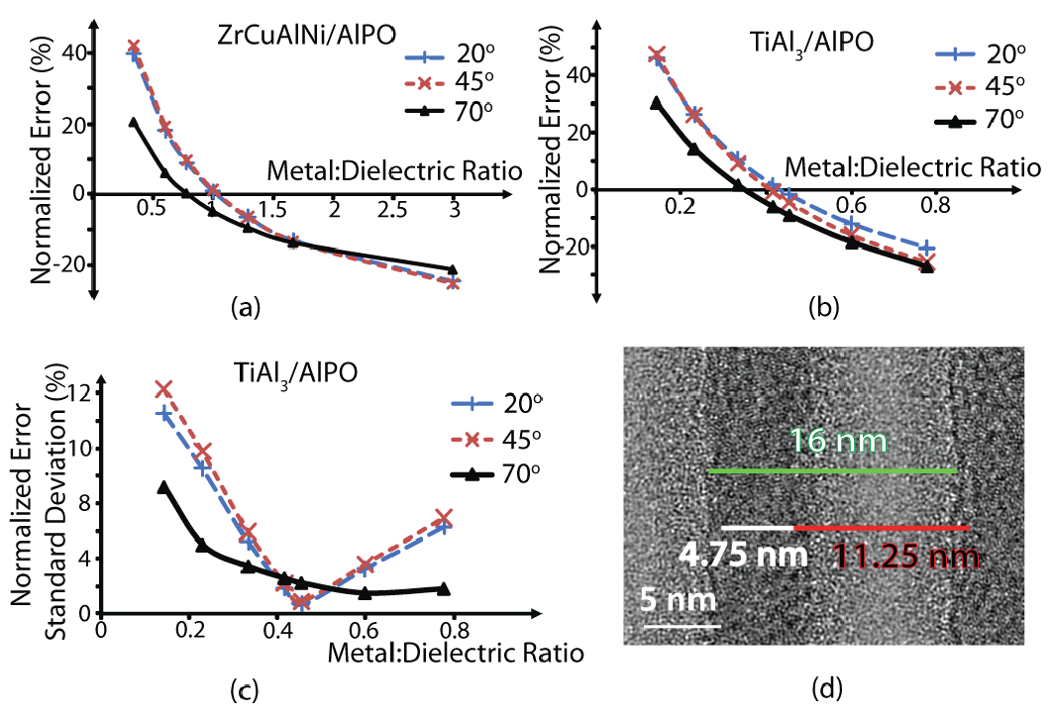
Error Analysis

Slide 22
Acknowledgements
OSU Electrical Engineering:
William Cowell – (Sputtering Metal)
John Wager
OSU Chemistry:
Christopher Knutson – (Spin Coating Dielectric)
Doug Keszler
OSU Material Science:
Brady Gibbons - Ellipsometry
OSU Physics:
David McIntyre
Advisor:
Viktor Podolskiy

Slide 23
Conclusions:
Ultra-thin nanostructures with atomically smooth interfaces reproducibly fabricated.
Bulk amorphous metals display interesting AC conductivity response.
Optical properties are consistent with anisotropic hyperbolic effective material response.
Applications and Outlook:
Dispersion Engineering (customized index of refraction)
Optical Filters
Subwavelength light compression
Waveguide systems
Stealth Coatings
Solar Cells (more than reflectors?)
Anisotropic Thermal Conduction

